Slide 1


Ian McMeeking
August 26, 2022

Slide 2

Outline
Executive Summary
Introduction
Methodology
Results
Conclusion
Appendix

Slide 3
Executive Summary
Data was scraped from Wikipedia and the SpaceX API on the launch characteristics and results of many Falcon 9 launches. This data was cleaned and then analyzed using numerous data visualizations, SQL queries, and classification algorithms to determine factors that impact the success of the Falcon 9’s reusable first stage booster.
It was found that launch date was a strong predictor of a successful landing, with later years having higher success rates. Heavier payloads and launches at the Kennedy Space Center also correlated with higher success rates, but this may be due to the fact that heavier payloads and launches at KSC occurred more frequently in later years. Some of the most successful rocket boosters are those of the FT category, which have a high success rate with medium-sized payloads ranging from 1,000 to 6,000 kg. A number of classification algorithms (KNN, logistic regression, and SVM) were found to predict the results of launches with a high accuracy of 80-85%.

Slide 4
Introduction
As private companies become more and more involved in spaceflight, SpaceX has emerged as an industry leader. One of SpaceX’s important innovations is the Falcon 9 rocket, a two-stage rocket with a reusable first stage. Successful repeated use of the first stage leads to huge cost reductions, so it is important for SpaceX and competitors to understand how successfully the first stage can be reused and what factors influence its success. Using data from the SpaceX API and Wikipedia, the following questions were investigated:
What factors influence the success of the first stage? Examples include launch date, payload mass, orbit type, launch location, booster version, etc…
How accurately can the success of the first stage be predicted?
Notes:
PROMPTS:
Project background and context
Problems you want to find answers

Slide 5

Section 1

Slide 6
Methodology
Executive Summary
Data collection methodology:
SpaceX API, web scraping Wikipedia
Perform data wrangling
Handling missing data
One-hot encoding of categorical variables
Coding launch outcomes as successes and failures
Perform exploratory data analysis (EDA) using visualization and SQL
Perform interactive visual analytics using Folium and Plotly Dash
Perform predictive analysis using classification models
Develop models with KNN, decision tree, logistic regression, and SVM algorithms
Optimize models with grid search
Compare models with accuracy scores and confusion matrices

Slide 7
Data Collection
Data was collected from two key sources:
The SpaceX API, and
Wikipedia

Slide 8
Data Collection – SpaceX API
Initial API Call
Secondary API Calls
Filter and Clean Results
Request data on all Falcon rocket launches
Use ID codes from initial call to request more information on rocket, payload, launchpad, and cores
Filter out launches that did not use Falcon 9 rocket
Fill in missing payload masses with the mean
GitHub: 1. Data Collection API Lab

Slide 9
Data Collection - Scraping
Request Page by URL
Extract Tables and Headers
Populate Dataframe
Get the HTML for the Wikipedia page on Falcon 9 launches
Find all tables of rocket launch data
Extract data from table cells to populate Pandas DataFrame
Create a Beautiful Soup object to parse
Extract headers to set up columns of a Pandas DataFrame
GitHub: 2. Data Collection With Web Scraping

Slide 10
Data Wrangling
Survey Data Types & Values
Identify Types of Landings
Create Target Variable
Check the number of missing values and data type for each column
Check number of launches per site and orbit type
View all values of landing_class column
Categorize each value as success/failure
Based on landing_class, create new column of binary success or failure values (1 or 0)
GitHub: 3. Data Wrangling
Notes:
Describe how data were processed
You need to present your data wrangling process using key phrases and flowcharts
Add the GitHub URL of your completed data wrangling related notebooks, as an external reference and peer-review purpose

Slide 11
EDA with SQL
Survey launch sites, payload masses, and booster versions
Check dates and booster versions of successful and failed landings
View the most common landing outcomes
GitHub: 4. Exploratory Data Analysis With SQL
Notes:
Using bullet point format, summarize the SQL queries you performed
Add the GitHub URL of your completed EDA with SQL notebook, as an external reference and peer-review purpose

Slide 12
EDA with Data Visualization
Categorical scatterplots were used to visualize how flight number, payload mass, and launch site interact with landing outcomes
A bar chart was used to visualize the success rate of launches with different orbit types
A line chart was used to show the trend of more successful launches in later years
GitHub: 5. Exploratory Data Visualization
Notes:
Summarize what charts were plotted and why you used those charts
Add the GitHub URL of your completed EDA with data visualization notebook, as an external reference and peer-review purpose

Slide 13
Build an Interactive Map with Folium
Circles and markers were added to a Folium map showing the locations of the 4 launch sites
Clusters show each successful and failed launch at each site
Annotated lines show the distance from launch sites to nearby features, specifically coastlines and cities
GitHub: 6. Launch Site Locations (Folium)
Notes:
Summarize what map objects such as markers, circles, lines, etc. you created and added to a folium map
Explain why you added those objects
Add the GitHub URL of your completed interactive map with Folium map, as an external reference and peer-review purpose

Slide 14
Build a Dashboard with Plotly Dash
Using a dropdown, data can be viewed for a single launch site or all launch sites
A pie chart shows the proportion of successful launches to easily compare each launch site
A scatter plot shows the payload mass, booster version category, and outcome of each launch
A range slider can be used to set the range of payload masses displayed
GitHub: 7. Interactive Dashboard (Plotly Dash)
Notes:
Summarize what plots/graphs and interactions you have added to a dashboard
Explain why you added those plots and interactions
Add the GitHub URL of your completed Plotly Dash lab, as an external reference and peer-review purpose

Slide 15
Predictive Analysis (Classification)
Standardize and Split Data
Develop Models
Standardize each feature variable
Split the data into a training set and testing set
Employed KNN, logistic regression, SVM, and decision tree algorithms
Grid search was used to select optimal hyperparameters
Accuracy scores and confusion matrices were used to compare model performance
Compare Models
GitHub: 8. Machine Learning Predictions
Notes:
Summarize how you built, evaluated, improved, and found the best performing classification model
You need present your model development process using key phrases and flowchart
Add the GitHub URL of your completed predictive analysis lab, as an external reference and peer-review purpose

Slide 16
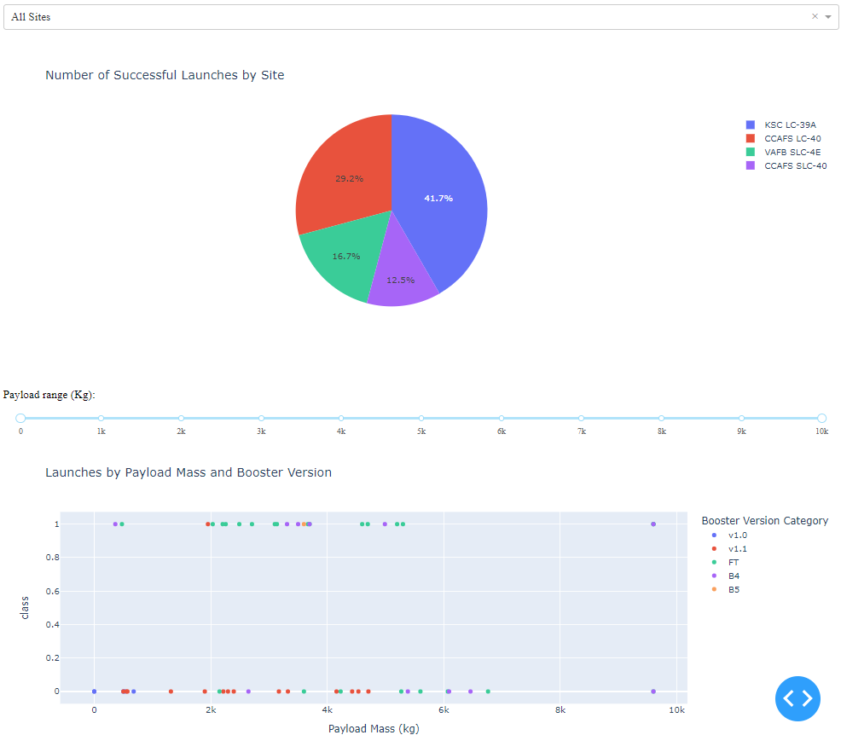
Results
Exploratory Data Analysis:
Success rate of launches improved from year to year
Heavier payloads and launches at Kennedy Space Center correlate with successful landings
The FT boosters had a high success rate
Predictive Analysis:
Models can predict with high accuracy (80-85%) whether past launches were successful
3 algorithms (logistic regression, SVM, KNN) had nearly identical performance
Notes:
Exploratory data analysis results
Interactive analytics demo in screenshots
Predictive analysis results

Slide 17

Section 2

Slide 18
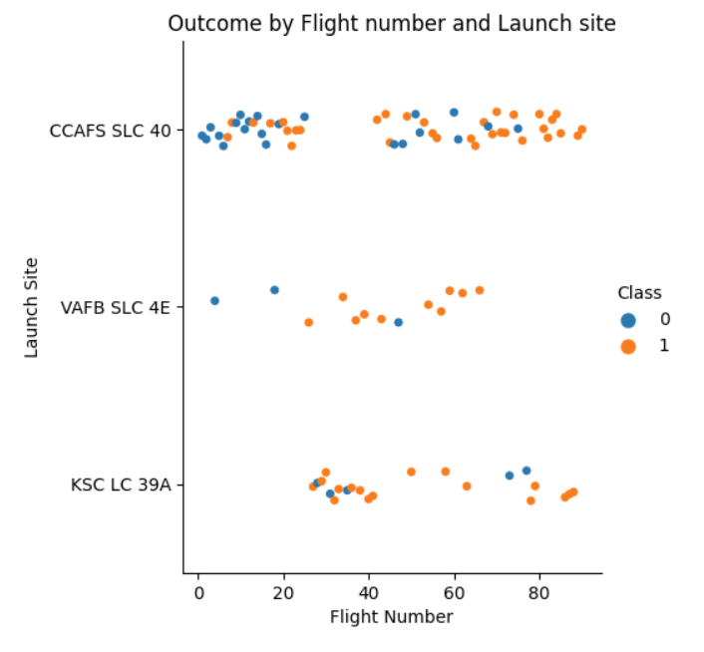
Flight Number vs. Launch Site
Higher flight numbers correlated with a higher success rate at CCAFS SLC 40 and at VAFB SLC 4E
CCAFS SLC 40 had the lowest success rate of all launch sites
The proportion of successful landings is greater for higher flight numbers

Slide 19
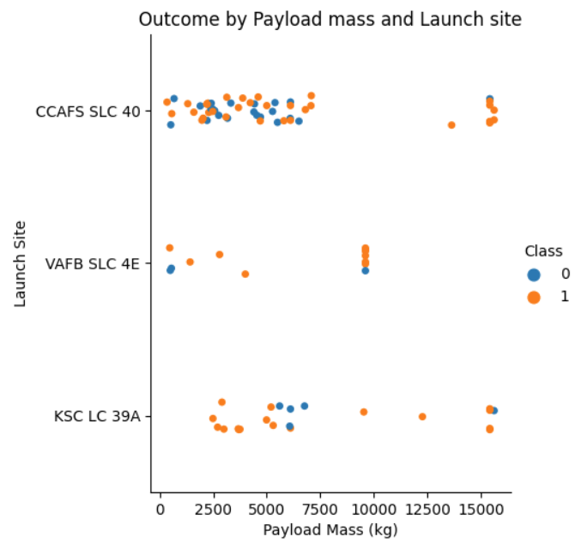
Payload vs. Launch Site
Higher payloads were correlated with more successful launches, especially at CCAFS SLC 40
VAFB SLC 4E had the fewest launches and, on average, the lightest payloads

Slide 20
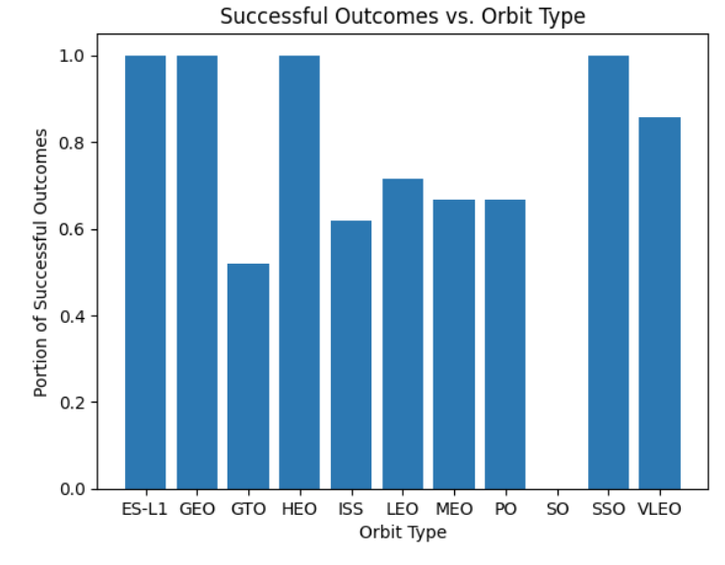
Success Rate vs. Orbit Type
Launches to ES-L1, GEO, HEO, and SSO all had 100% success rates
There were no successful launches to SO
*notably, for most of these orbit types (ES-L1, GEO, HEO, and SO), there was only one attempted launch

Slide 21
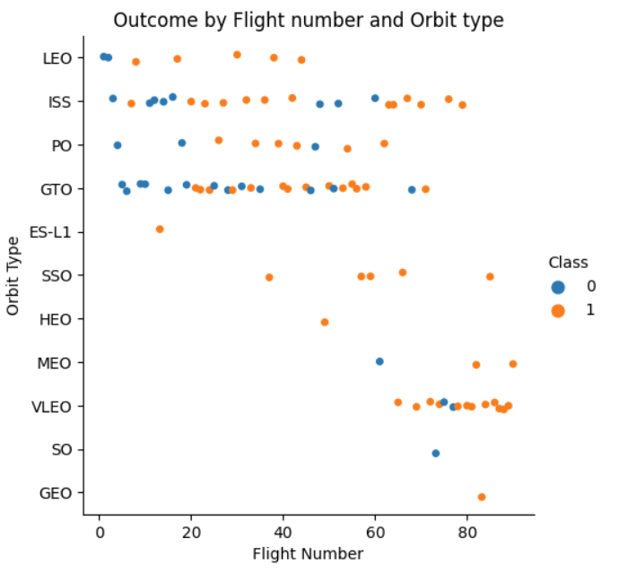
Flight Number vs. Orbit Type
Early launches (flight number < 50) mostly aimed for 4 types of orbit: LEO, ISS, PO, and GTO
Recently (flight number > 65), VLEO has been a popular and successful destination

Slide 22
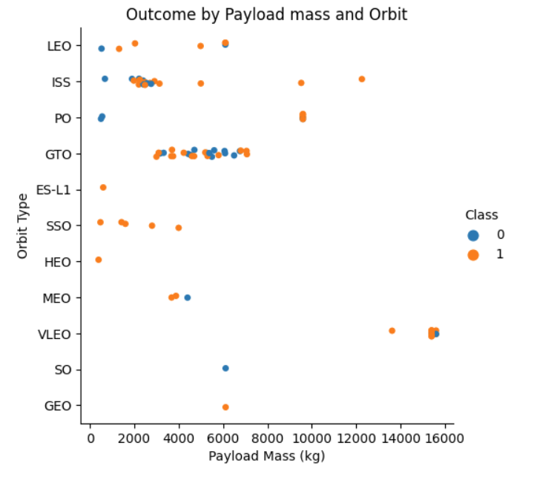
Payload vs. Orbit Type
The heaviest payloads (> 13,000 kg) have all been launched to VLEO
Except for launches to GTO, nearly all payloads over 6,000 kg have had successful outcomes

Slide 23
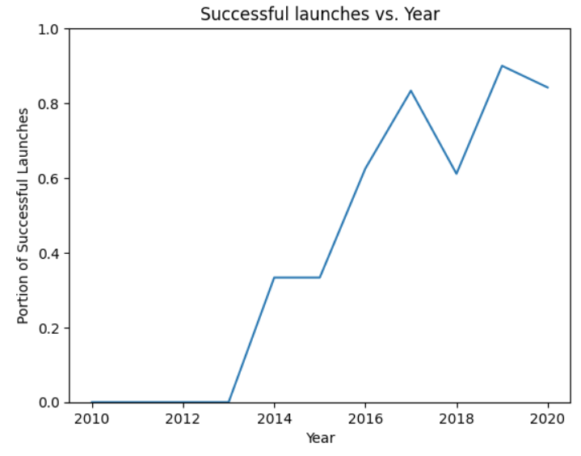
Launch Success Yearly Trend
The success rate increased dramatically from 0% in 2010 to over 80% in 2020

Slide 24
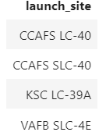
All Launch Site Names
The four unique launch sites are:

Slide 25
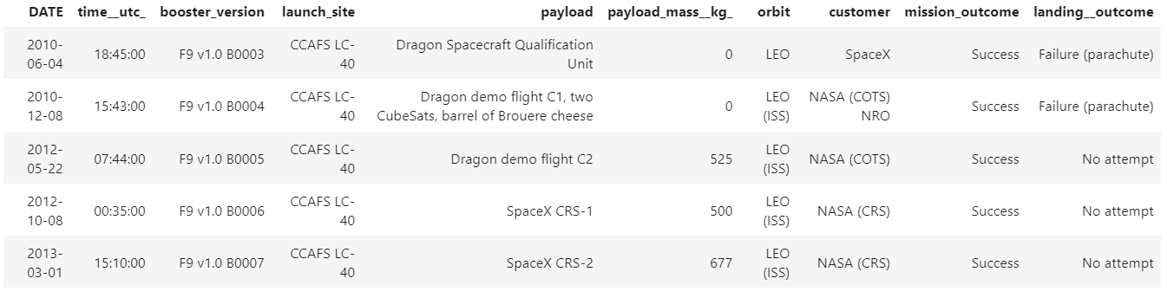
Launch Site Names Begin with 'CCA'
The first 5 launches from sites beginning with `CCA` are:

Slide 26
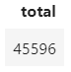
Total Payload Mass
In kg, the total payload mass carried by boosters from NASA is:

Slide 27
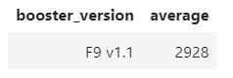
Average Payload Mass by F9 v1.1
The v1.1 boosters carried a light average payload:

Slide 28
First Successful Ground Landing Date
The first successful landing on a ground pad was in December, 2015:

Slide 29
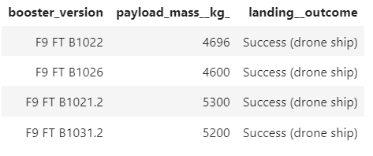
Successful Drone Ship Landing with Payload between 4000 and 6000
Variants of the FT booster (and no other boosters) were used successfully to land payloads between 4,000-6,000 kg on drone ships:

Slide 30
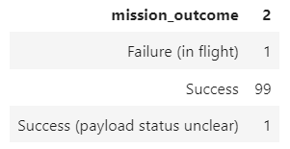
Total Number of Successful and Failure Mission Outcomes
Only 1-2 missions were unsuccessful (column 2 shows the tally):

Slide 31
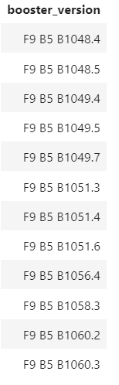
Boosters Carried Maximum Payload
Only variants of the B5 booster have carried the maximum payload mass:

Slide 32
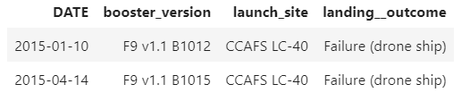
2015 Launch Records
The two failed launches were launched at CCAFS LC-40 with v1.1 boosters:

Slide 33
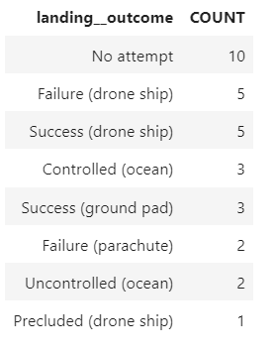
Rank Landing Outcomes Between 2010-06-04 and 2017-03-20
No attempt was made to land a number of launches between 2010-06-04 and 2017-03-20, and about half of landing attempts involved drone ships:

Slide 34

Section 3

Slide 35
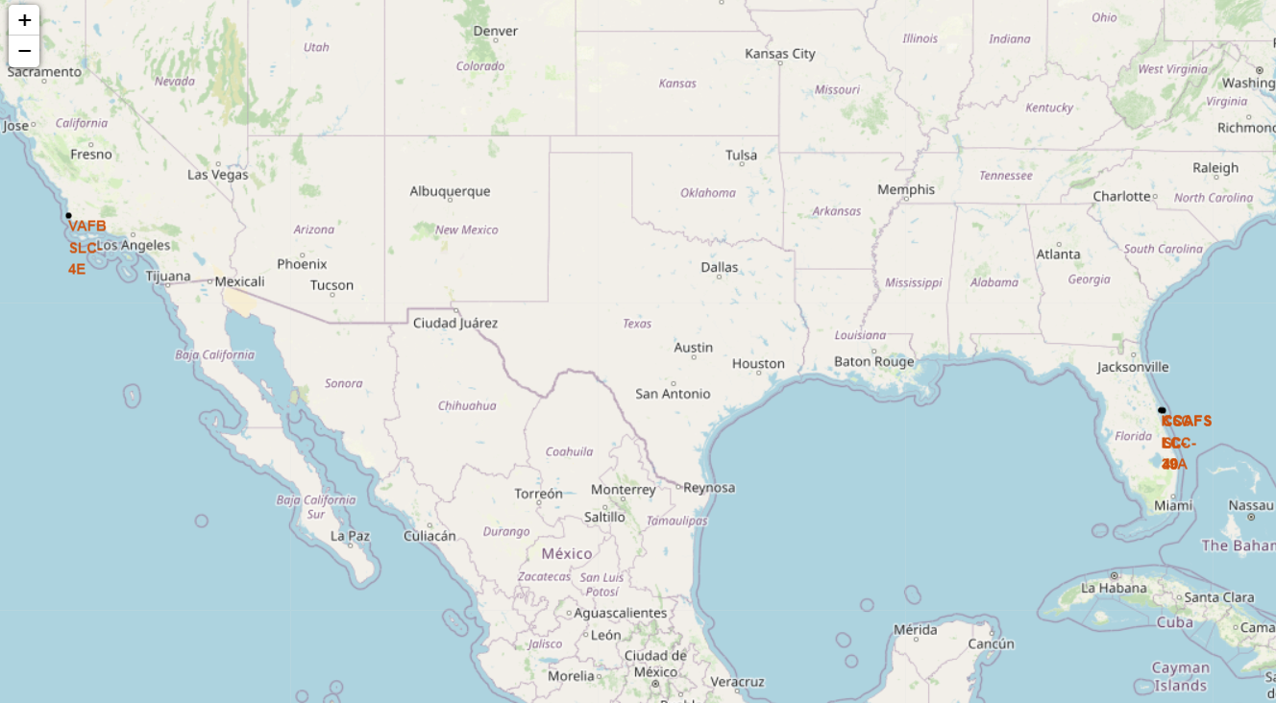
Folium - SpaceX Launch Site Locations
There are four launch sites:
1 in southern California
3 clustered in Florida
All sites are in the southern US along the coast
Notes:
Replace <Folium map screenshot 1> title with an appropriate title
Explore the generated folium map and make a proper screenshot to include all launch sites’ location markers on a global map
Explain the important elements and findings on the screenshot

Slide 36
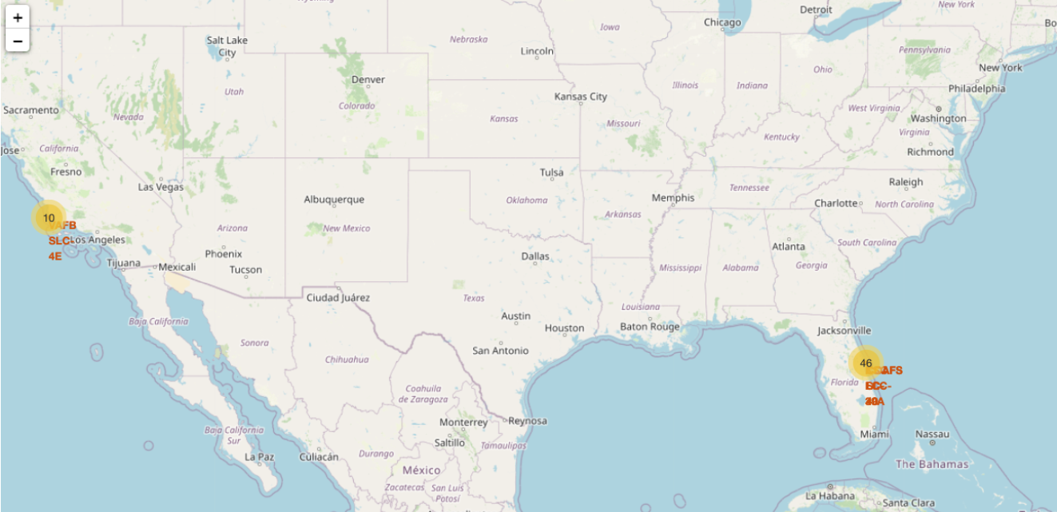
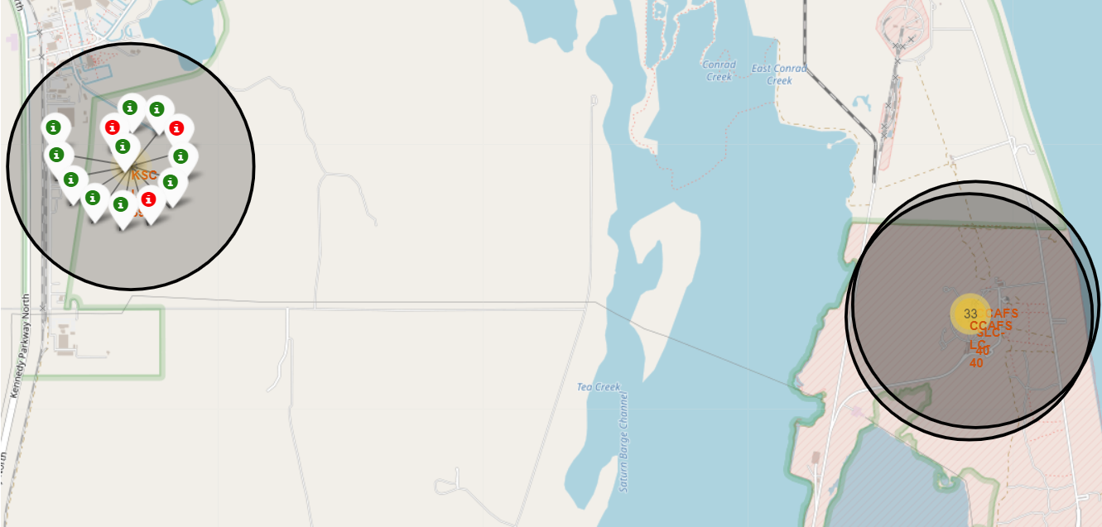
Folium - Successful and Failed Launch Landings
The large majority of launches occurred at the launch sites in Florida
The site with the highest success rate was Kennedy Space Center
Notes:
Replace <Folium map screenshot 2> title with an appropriate title
Explore the folium map and make a proper screenshot to show the color-labeled launch outcomes on the map
Explain the important elements and findings on the screenshot

Slide 37
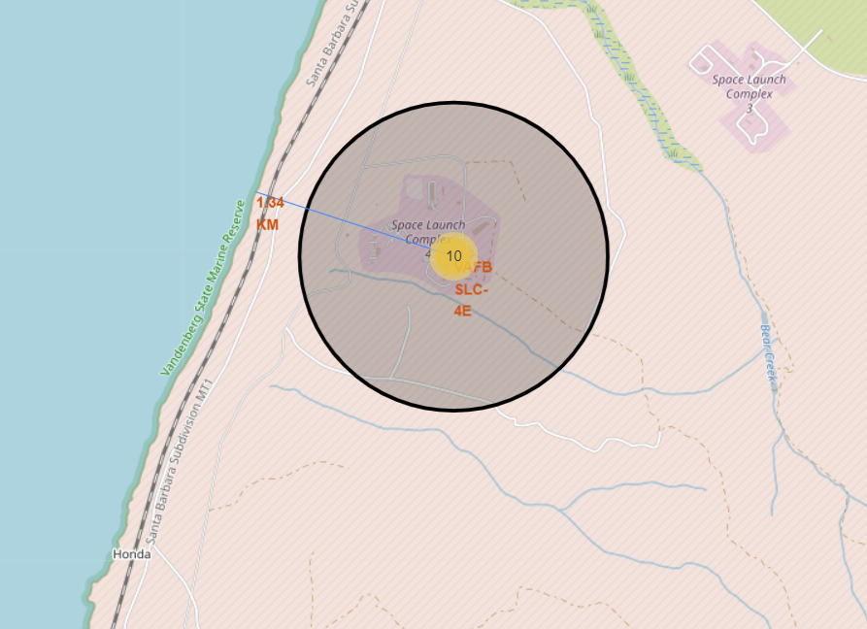
Folium – Distances to Nearby Features
All launch sites are near the ocean
For example, VAFB SLC-4E is about 1.34 kilometers from the Pacific Ocean
Notes:
Replace <Folium map screenshot 3> title with an appropriate title
Explore the generated folium map and show the screenshot of a selected launch site to its proximities such as railway, highway, coastline, with distance calculated and displayed
Explain the important elements and findings on the screenshot

Slide 38

Section 4

Slide 39
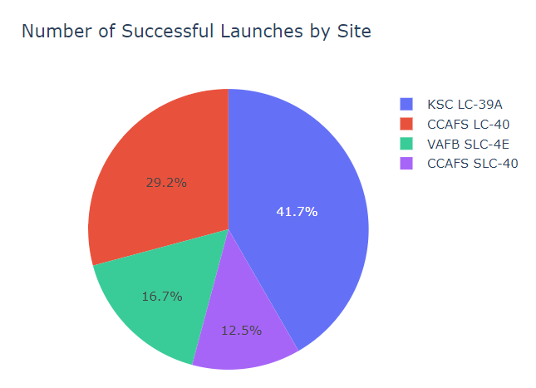
Dash – Successful Launches by Site
The largest number of successful launches occurred at KSC LC-39A
The smallest number of successful launches occurred at CCAFS SLC-40
Notes:
Replace <Dashboard screenshot 1> title with an appropriate title
Show the screenshot of launch success count for all sites, in a piechart
Explain the important elements and findings on the screenshot

Slide 40
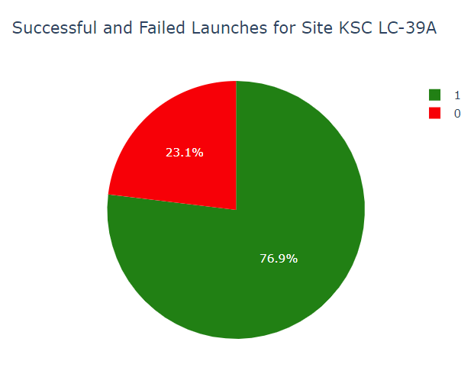
Dash – The Most Successful Site
By far, the site with the highest success rate was KSC LC-39A (Kennedy Space Center)
Over ¾ of the launches at KSC had successful landings, compared to less than ½ at all other sites
Notes:
Replace <Dashboard screenshot 2> title with an appropriate title
Show the screenshot of the piechart for the launch site with highest launch success ratio
Explain the important elements and findings on the screenshot

Slide 41
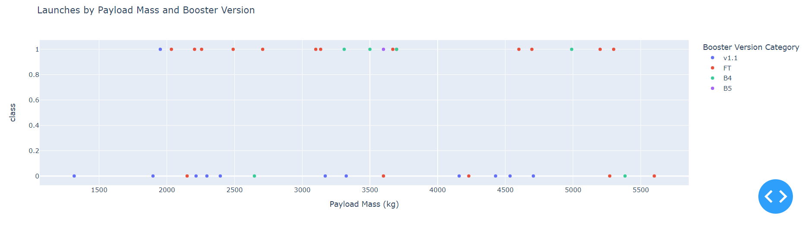
Dash – The Most Successful Payloads & Booster
Most successful landings had payloads between 1000 and 6000 kg
Of these successful landings, most used a FT booster
Notes:
Replace <Dashboard screenshot 3> title with an appropriate title
Show screenshots of Payload vs. Launch Outcome scatter plot for all sites, with different payload selected in the range slider
Explain the important elements and findings on the screenshot, such as which payload range or booster version have the largest success rate, etc.

Slide 42

Section 5

Slide 43
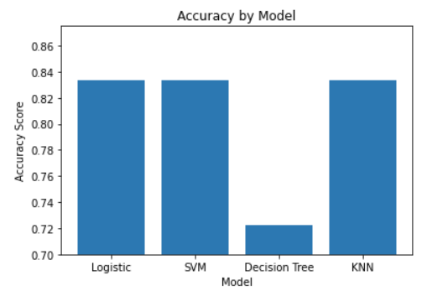
Classification Accuracy
All models other than the decision tree had identical accuracy, correctly predicting 15/18 outcomes
In addition, they had virtually identical performance on the training data

Slide 44
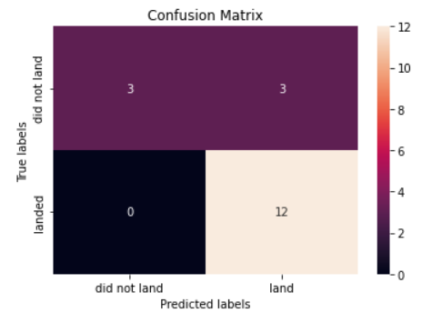
Confusion Matrix
The confusion matrix for the logistic regression, support vector machine, and k-nearest neighbor models is shown *as noted before, all models performed identically on the test set
The models predicted perfectly on test samples where the launch landed
However, the models performed poorly (50% accuracy) on test samples where the launch did not land

Slide 45
Conclusions
Launch date was the strongest predictor of a successful landing. Successful landings increased from 0% in 2010 to over 80% in 2020.
Launch site and payload mass were also strong predictors. Kennedy Space Center has a successful track record, and heavier payloads have been launched with a high success rate.
FT boosters have been used very successfully, especially with medium-sized payloads (1,000-6,000 kg)
Classification algorithms can predict the success of a launch with a high degree of accuracy (80-85%)
Logistic regression, support vector machines, and k-nearest neighbor all accomplished this

Slide 46


